Slide 1
Procedural Modeling Project
Jaime Manuel Trillos Ujueta
Bonn University – March 2018

Slide 2
Modeling
Define a procedural grammar suitable for describing a room (including windows, doors, ...).
Parse a grammar file of such a procedural description.
Define the data structure for grammar and geometry (tree structure).
Apply procedural rules, generate room geometry and store it into the data structure.
Pass the intermediate result to renderer.

Slide 3
Procedural Grammar for Describing a Room
Definition of a rule:
Head=Rules operators:Probability
Example:
main=S(20,20,20) Subdiv(0,20){house}
wall1=Subdiv(1,5,10,5){wallpaper,wallMiddle1,wallpaper}:0.6
wall1=Subdiv(1,20){wallpaper}:0.4
The file can have comments using at the beginning #

Slide 4
Procedural Grammar for Describing a Room
There are different operators that can be use:
T(X,Y,Z) : Translation of an object
Comp(type){parameters} : Split scope into plains
Subdiv(axis,arguments){parameters} : Divide scope in smaller scopes (children)
I(typeObject){texture} : Instance of a figure
S(X,Y,Z) : Set new size
S3d(axis,size) : Set new size for an specific axis
R(angleX,angley,angleZ) : Rotating around axis
Axis are X=0, Y=1, Z=2
Taken:
P. Muller, G. Zeng, P. Wonka, and L. Van Gool. Image-based ¨ procedural modeling of facades. In SIGGRAPH, 2007

Slide 5
Procedural Grammar for Describing a Room
There are different typeObjects:
enum TypeObject { INACTIVE, SCOPE, PLAIN, CUBE, CYLINDER, SOFA, TABLE, CABINET, CHAIR, TOY };

Slide 6
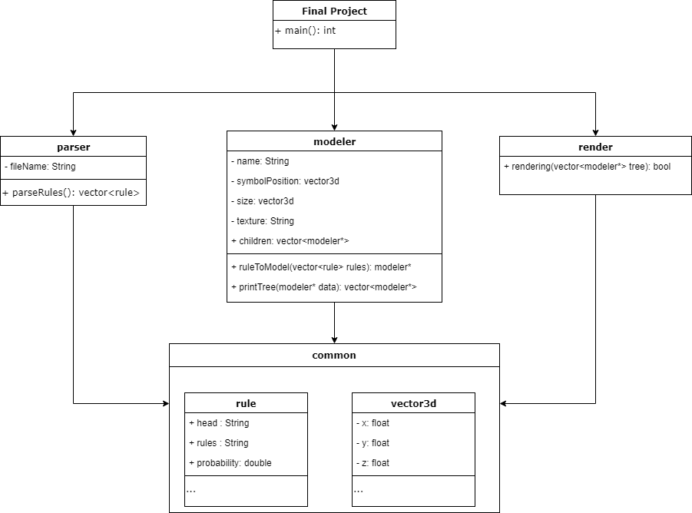
Oriented Object Model

Slide 7
Parsing the File
Steps:
Read the file and save it in a vector<string>.
Parse the vector<string> into a vector<rule>.
Save the repeat heads in a temporal vector<rule>.
Create a random between 0 and 1.
Find the nearest probability with the random; save the winner in another vector<rule>.
Erase the losers from the original vector<rule>.
And repeat it until there is no more repeat heads.
Return the vector<rule>

Slide 8
Modeler: Data Structure (Tree)
Steps:
Transform the vector<rule> into a map<string,string>
Initialize the model (modeler* tree) and add the model in vector<modeler*> list (global variable)
Copy the first model in the list in a temporal variable (modeler* currentModel) and extract the head in another variable (string modelerName)
Erase the first element of the list
Search in the map if the head exist with respect to modelerName
Extract the rules and parse until have each operator rule (vector<string> keys)
Compare if the keys start with (T,S,S3d,Subdiv,Comp,I,…)
Transform the rules in model. If it contain children e.g Subdiv then save it in the model but also adding it to the vector<modeler*> list
Do the process until there is no more models in the list
Return the tree

Slide 9
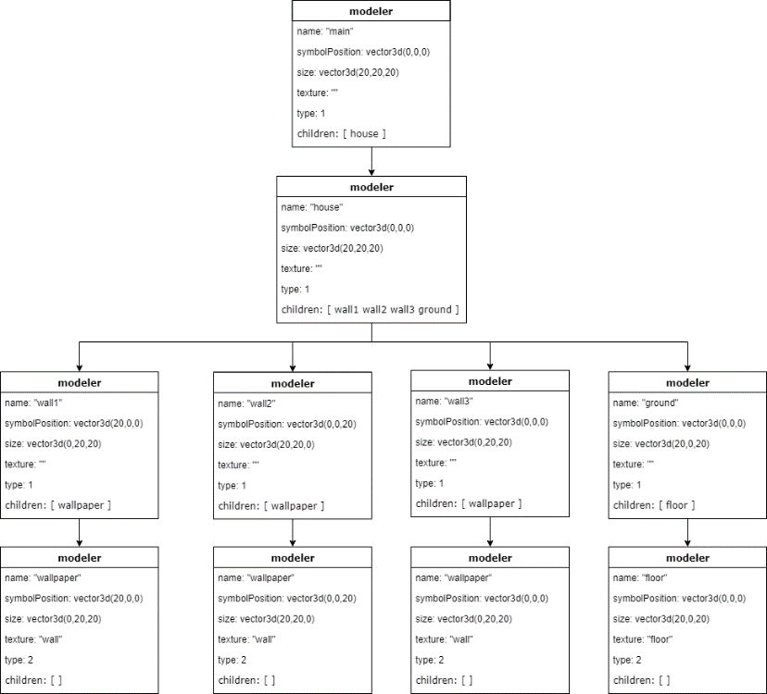
Tree Structure
Type 1 = SCOPE
Type 2 = PLAIN

Slide 10
Result to Rendering
Steps:
Transform the modeler* tree in a vector<modeler*> model
Save the model in a global variable
Call the function drawTree(Shader ourShader)
Save the respective model in the ourShader variable and render it.
The program permits zoom, movement in the scene with the WASD/arrow keys and mouse.

Slide 11
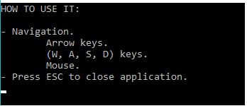
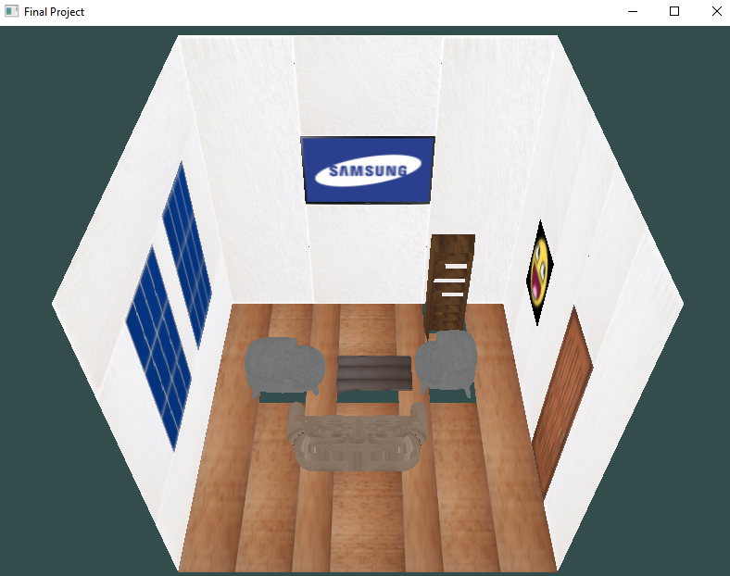
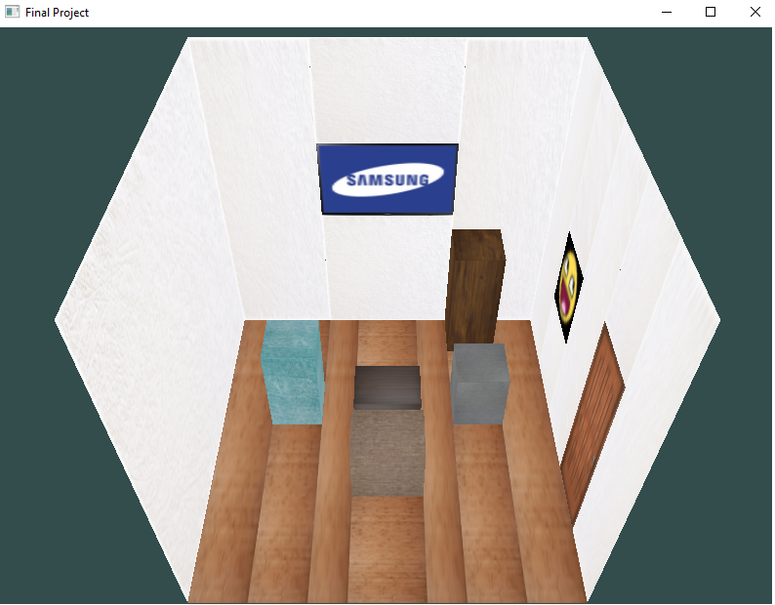
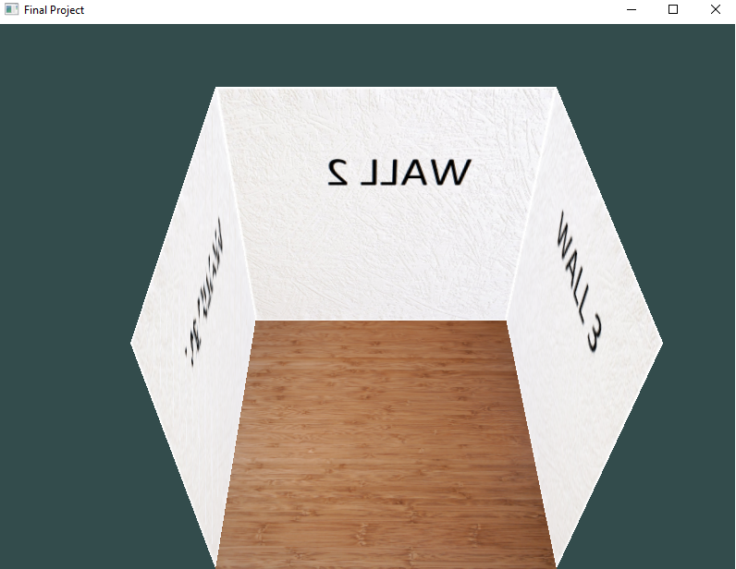
Screenshots

Slide 12
Thank you. Questions?

